Slide 1
Software Testing and Quality Assurance (CST-311)
Department:- Computer Science & Engineering
Unit -2
Chapter 2
Lecture 2.3

Slide 2
Contents
What is White Box Testing?
What do you verify in White Box Testing?
How do you perform White Box Testing?
White Box Testing example
Why we perform White Box Testing?
Types of White Box Testing
White Box Testing Techniques
White Box Testing Example based on Techniques
White Box Testing Tools

Slide 3
What is White Box Testing?
It is testing a software solution's internal structure, design, and coding.
It is also known as Clear Box testing, Open Box testing, Structural testing, Transparent Box testing, Code-Based testing, and Glass Box testing.
It is usually performed by developers.
In this type of testing, the code is visible to the tester.
It focuses primarily on verifying the flow of inputs and outputs through the application, improving design and usability, strengthening security.

Slide 4
What do you verify in White Box Testing?
White box testing involves the testing of the software code for the following:
Internal security holes
Broken or poorly structured paths in the coding processes
The flow of specific inputs through the code
Expected output
The functionality of conditional loops
Testing of each statement, object, and function on an individual basis
The testing can be done at system, integration and unit levels of software development. One of the basic goals of white box testing is to verify a working flow for an application. It involves testing a series of predefined inputs against expected or desired outputs so that when a specific input does not result in the expected output, you have encountered a bug.

Slide 5
How do you perform White Box Testing?
To give a simplified explanation of white box testing, we have divided it into two basic steps. This is what testers do when testing an application using the white box testing technique:
STEP 1) UNDERSTAND THE SOURCE CODE
The first thing a tester will often do is learn and understand the source code of the application. Since white box testing involves the testing of the inner workings of an application, the tester must be very knowledgeable in the programming languages used in the applications they are testing.
Also, the testing person must be highly aware of secure coding practices. Security is often one of the primary objectives of testing software.
The tester should be able to find security issues and prevent attacks from hackers and naive users who might inject malicious code into the application either knowingly or unknowingly.

Slide 6
How do you perform White Box Testing?
STEP 2) CREATE TEST CASES AND EXECUTE
The second basic step to white box testing involves testing the application's source code for proper flow and structure. One way is by writing more code to test the application's source code.
The tester will develop little tests for each process or series of processes in the application. This method requires that the tester must have intimate knowledge of the code and is often done by the developer.

Slide 7
White Box Testing Example
Consider the following piece of code
Printme (int a, int b) {
int result = a+ b;
If (result> 0)
Printf ("Positive", result)
Else
Print ("Negative", result) }
The goal of White Box testing in software engineering is to verify all the decision branches, loops, statements in the code.
To exercise the statements in the above code, White Box test cases would be
A = 1, B = 1
A = -1, B = -3

Slide 8
Why we perform White Box Testing?
To ensure:
That all independent paths within a module have been exercised at least once.
All logical decisions verified on their true and false values.
All loops executed at their boundaries and within their operational bounds internal data structures validity.
To discover the following types of bugs:
Logical error tend to creep into our work when we design and implement functions, conditions or controls that are out of the program
The design errors due to difference between logical flow of the program and the actual implementation
Typographical errors and syntax checking

Slide 9
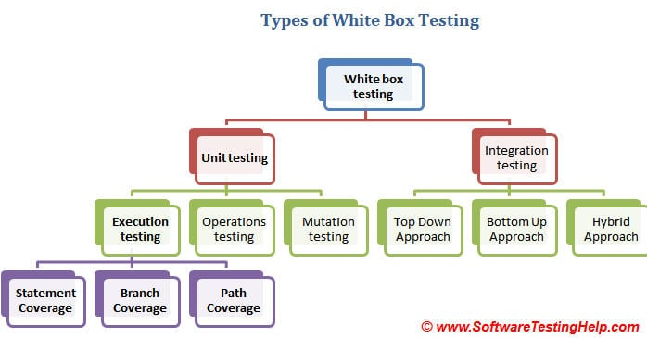
Types of White Box Testing
There are several types and different methods for each white box testing type.

Slide 10
White Box Testing Techniques
Statement Coverage
Branch Coverage
Path Coverage
Note that the statement, branch or path coverage does not identify any bug or defect that needs to be fixed. It only identifies those lines of code which are either never executed or remains untouched. Based on this further testing can be focused on.
Let’s understand these techniques one by one with a simple example.
1. Statement coverage:
In a programming language, a statement is nothing but the line of code or instruction for the computer to understand and act accordingly.
A statement becomes an executable statement when it gets compiled and converted into the object code and performs the action when the program is in a running mode.

Slide 11
White Box Testing Techniques
Hence “Statement Coverage”, as the name itself suggests, it is the method of validating whether each and every line of the code is executed at least once.
2. Branch Coverage:
“Branch” in a programming language is like the “IF statements”.
An IF statement has two branches: True and False.
So in Branch coverage (also called Decision coverage), we validate whether each branch is executed at least once.
In case of an “IF statement”, there will be two test conditions:
One to validate the true branch and,
Other to validate the false branch.
Hence, in theory, Branch Coverage is a testing method which is when executed ensures that each and every branch from each decision point is executed.

Slide 12
White Box Testing Techniques
3. Path Coverage
Path coverage tests all the paths of the program.
This is a comprehensive technique which ensures that all the paths of the program are traversed at least once.
Path Coverage is even more powerful than Branch coverage.
This technique is useful for testing the complex programs.

Slide 13
White Box Testing Example
Consider the below simple pseudocode:
INPUT A & B
C = A + B
IF C>100
PRINT “ITS DONE”
For Statement Coverage – we would only need one test case to check all the lines of the code.
That means:
If I consider TestCase_01 to be (A=40 and B=70), then all the lines of code will be executed.
Now the question arises:
Is that sufficient?
What if I consider my Test case as A=33 and B=45?
Because Statement coverage will only cover the true side, for the pseudo code, only one test case would NOT be sufficient to test it. As a tester, we have to consider the negative cases as well.

Slide 14
White Box Testing Example
Hence for maximum coverage, we need to consider “Branch Coverage”, which will evaluate the “FALSE” conditions.
In the real world, you may add appropriate statements when the condition fails.
So now the pseudo code becomes:
INPUT A & B
C = A + B
IF C>100
PRINT “ITS DONE”
ELSE
PRINT “ITS PENDING”
Since Statement coverage is not sufficient to test the entire pseudo code, we would require Branch coverage to ensure maximum coverage.

Slide 15
White Box Testing Example
So for Branch coverage, we would require two test cases to complete the testing of this pseudo code.
TestCase_01: A=33, B=45
TestCase_02: A=25, B=30
With this, we can see that each and every line of the code is executed at least once.
Here are the Conclusions that are derived so far:
Branch Coverage ensures more coverage than Statement coverage.
Branch coverage is more powerful than Statement coverage.
100% Branch coverage itself means 100% statement coverage.
But 100 % statement coverage does not guarantee 100% branch coverage.

Slide 16
White Box Testing Example
For Path Coverage
Consider this pseudo code:
INPUT A & B
C = A + B
IF C>100
PRINT “ITS DONE”
END IF
IF A>50
PRINT “ITS PENDING”
END IF
Now to ensure maximum coverage, we would require 4 test cases.
How? Simply – there are 2 decision statements, so for each decision statement, we would need two branches to test. One for true and the other for the false condition. So for 2 decision statements, we would require 2 test cases to test the true side and 2 test cases to test the false side, which makes a total of 4 test cases.

Slide 17
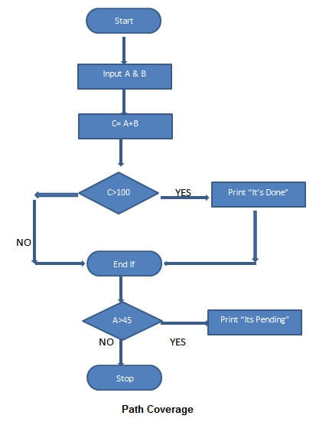
White Box Testing Example

Slide 18
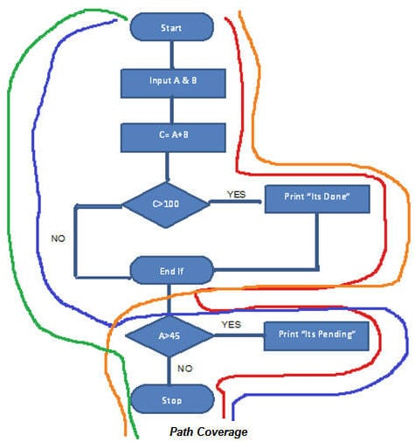
White Box Testing Example
In order to have the full coverage, we would need following test cases:
TestCase_01: A=50, B=60
TestCase_02: A=55, B=40
TestCase_03: A=40, B=65
TestCase_04: A=30, B=30
So the path covered will be:
Red Line – TestCase_01 = (A=50, B=60)
Blue Line = TestCase_02 = (A=55, B=40)
Orange Line = TestCase_03 = (A=40, B=65)
Green Line = TestCase_04 = (A=30, B=30)

Slide 19
White Box Testing Tools
Veracode
EclEmma
RCUNIT
Cfix
Googletest
Emma
Nunit
CPPUnit
Junit
JSUnit

Slide 20
Summary
It focuses primarily on verifying the flow of inputs and outputs through the application, improving design and usability, strengthening security.
Statement Coverage” is the method of validating whether each and every line of the code is executed at least once.
Branch Coverage is a testing method which is when executed ensures that each and every branch from each decision point is executed.
Path Coverage is even more powerful than Branch coverage and is useful for testing the complex programs.

Slide 21
References
Text Books:
CemKaner, Jack Falk, HungQuoc Nguyen, Testing Computer Software, Wiley, (Second Edition).
William E. Perry,“ Effective Methods for Software Testing”, John Wiley & Sons.
Boris Beizer, ”Software Testing Techniques”, Second Edition, Dreamtech.
Reference Books:
Rex Black, “Managing the Testing Process: Practical Tools and Techniques for Managing Hardware and Software Testing”.
Daniel Galin, “Software Quality Assurance from Theory to Implementation”, Pearson Education.

Slide 22
THANK YOU

